Slide 1
AIE1903: Multimodal Agentic Assistant—Tool Use and Autonomous Systems
Lecture 2 — MLP, CNN, and Transformer Architectures
Ming Li | CUHK(SZ), SAI | Sep. 2026
How neural networks transform inputs into useful representations

Slide 2
Recap: Multimodal Input Processing
Raw images and text must become model-ready vectors.
IMAGE
RGB
image
→
Resize
Crop / Pad
→
Normalize
pixel values
→
Split into
patches
→
Projected
visual tokens
TEXT
User
text
→
Tokenizer
→
Token IDs
→
Text
embeddings
Both branches now contain vectors in the language model embedding space.
Projected visual tokens
+
Text embeddings
→
One multimodal
token sequence
The VLM reads the combined sequence and generates the response token by token.
Final checks: image size, value range, token order, embedding dimension

Slide 3
Learning Objectives
By the end of this lecture, you should be able to:
1. Understanding tensor shape changes through MLP, CNN, and Transformer networks.
2. Explain input and output of each major layer during inference.
3. Explain the concepts of convolutional kernels, feature maps, stride.
4. Describe how Transformer tokens gather context information from a sequence.
5. Select a suitable architecture for different types of input data.
Goal: understand inference data flow and outputs, without studying model training.

Slide 4
Three Ways to Mix Input Information
Input tensor
MLP
CNN
Transformer
Prediction
Different Connectivity Pattern
MLP mixes all features globally.
CNN uses shared filters to interact local features.
Transformer lets tokens exchange information through global attention.

Slide 5
Roadmap
Part I Neural-network foundations
Part II Multilayer Perceptrons (MLPs)
Part III Convolutional Neural Networks (CNNs)
Part IV Transformers and architecture comparison
4

Slide 6
Part I — Neural-Network Foundations
What is the repeated basic computation operation inside every deep network?
5

Slide 7
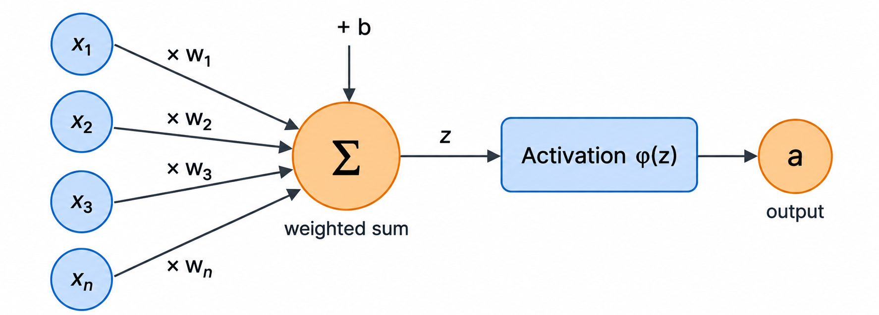
Matrix Computation and Adding
x is the input vector;
w contains learned weights;
b is a learned offset;
φ is an activation function.
z = wᵀx + b, a = φ(z)
Learning changes weights and biases—not the input formula.

Slide 8
A Linear Layer Transforms Feature Dimension
Input batch
X ∈ ℝᴮˣᴰⁱⁿ
B × D_in
Weight + bias
W, b
D_out × D_in; D_out
Output
Y = WᵀX + b
B × D_out
Dimension changes follow matrix multiplication.

Slide 9
Activation Functions Add Nonlinearity
ReLU
Sigmoid
max(0, x)
1 / (1 + e⁻ˣ)
Tanh
output in [−1, 1]
Nonlinearity allows stacked layers to represent curved decision boundaries.

Slide 10
Activation Example
Input x = [2, −1]
Linear: z = Wx + b
z = [1.5, −0.5]
ReLU
a = [1.5, 0]
The activation removes the negative response.
The same operation is applied across the batch;
the next layer receives a.

Slide 11
Track Tensor Shapes at Every Layer
Input X
[B, D_in]
Weights W
[D_out, D_in]
Bias b
[D_out]
Pre-activation Z
[B, D_out]
Output A
[B, D_out]
Most architecture bugs are shape mismatches, not difficult mathematics.

Slide 12
From Raw Output to a Prediction
01
One score for each class
Logits
02
Convert scores to probabilities
Softmax
03
Select the category with the largest probability
Decision
Result
The network produces numbers first. A decoding rule turns them into an answer.
Return a label or confidence

Slide 13
Roadmap
Part I Neural-network foundations ✓
Part II Multilayer Perceptrons (MLPs)
Part III Convolutional Neural Networks (CNNs)
Part IV Transformers and architecture comparison

Slide 14
Part II — Multilayer Perceptrons
What is the simplest neuron-wise connection way?

Slide 15
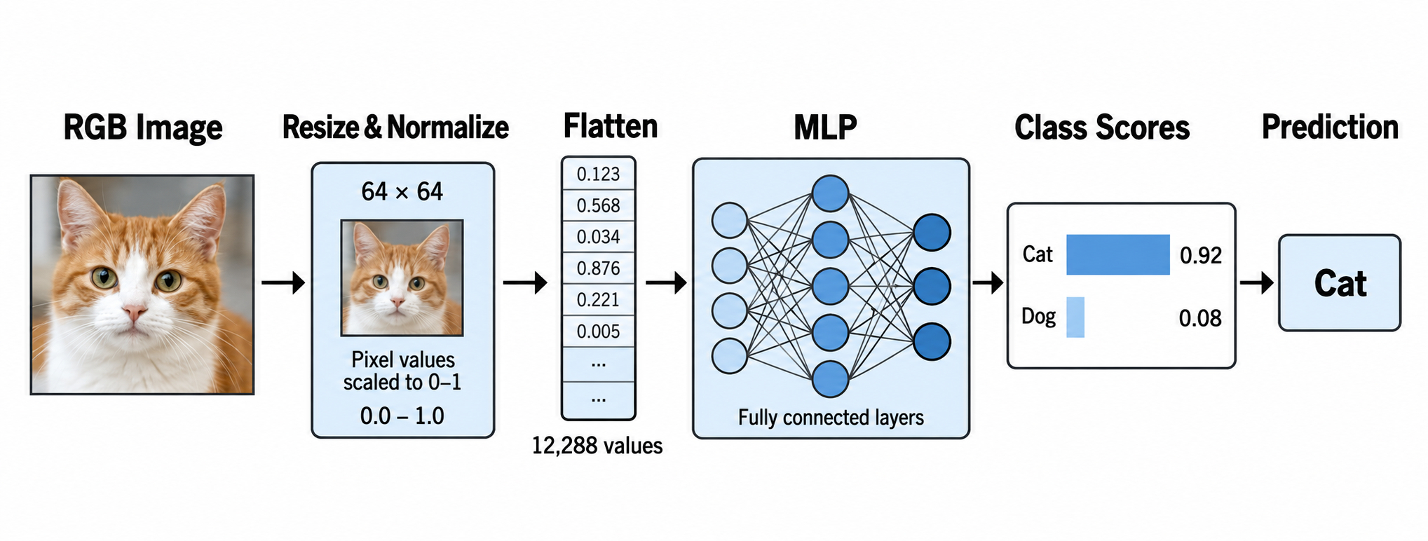
MLP Input Process Overview

Slide 16
How a Dense Layer Transforms Features
A dense layer transforms each input feature vector into a new feature vector.
Input features
x
Weighted sum
z = xW + b
Activation
h = φ(z)
Output features
h
[B, Dᵢ]
Each output neuron uses
all input features.
Adds nonlinearity
[B, Dₒᵤ]
Fully connected
Every output neuron receives information from every input feature.
Learnable parameters
W contains the weights, and b contains the bias.
Tensor shape
The batch size B stays the same. The feature dimension can change.

Slide 17
Why Use Several Dense Layers?
Patterns in data may be pretty complicated and mixed
Multiple layers combine those patterns into more useful representations.
A Single Layer detects simple combinations of input features.
Activation
adds nonlinear modelling capability

Slide 18
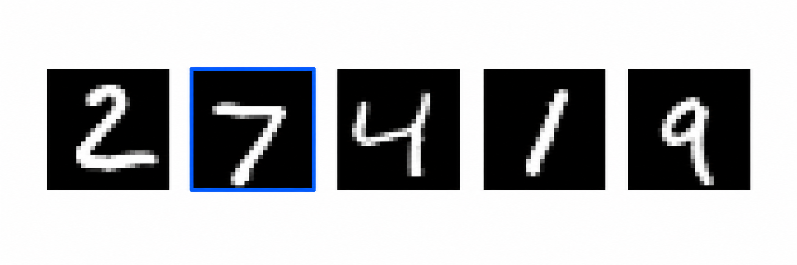
MLP Shape Example: Handwritten Digit Recognition
A batch contains 32 grayscale images. Each image shows one handwritten digit from 0 to 9.
Example images from the input batch
Predicted
digit
Input batch
28 × 28 images
[32, 28, 28]
Flatten
784 pixels
[32, 784]
Hidden layer 1
512 features
[32, 512]
Hidden layer 2
256 features
[32, 256]
Class scores
10 digits
[32, 10]
‘7’
32
images processed together in one batch
784
28 × 28 pixels after flattening
10
one score for each class: digits 0–9
argmax
selects the class with the highest score
Shape flow: [32, 28, 28] → [32, 784] → [32, 512] → [32, 256] → [32, 10]
1

Slide 19
Counting MLP Parameters
Layer
Parameters
L1: 784 → 512
401,920
L1: 512 → 256
131,328
Logits Layer: 256 → 10
2,570
Total
535,818
Dense layers scale with D_in × D_out.

Slide 20
Why Plain MLPs Struggle with Images
Flatten image
[B, H×W×C]
Destroys explicit 2D layout
Dense connections
Every pixel → every unit
Too many parameters
Fixed resolution
Input length is fixed
Hard to reuse a model across sizes

Slide 21
MLP: Strengths and Limitations
Strengths
Limitations
Simple and flexible
No locality or weight sharing
Strong baseline for tabular data and compact vectors;
easy to parallelize for GPU computations and debug.
Parameter count grows quickly;
spatial and sequence structure are ignored.
Use an MLP when the input is already a compact feature vector.

Slide 22
Roadmap
Part I Neural-network foundations ✓
Part II Multilayer Perceptrons ✓
Part III Convolutional Neural Networks (CNNs)
Part IV Transformers and architecture comparison
23

Slide 23
Part III — Convolutional Neural Networks
How can we reuse the same local pattern detector in a network?

Slide 24

Convolutional Feature Extraction Overview
Most of the model repeatedly applies convolution blocks to transform pixels into useful features.
RGB Image
CONVOLUTIONAL FEATURE EXTRACTOR
Resize
+ Normalize
Global
Pooling
[B, 3, H, W]
Conv block 1
Conv block 2
Conv block 3
edges
textures + parts
object features
Class scores
Dog 0.86
Cat 0.09
Other 0.05
Each block contains convolution, activation, and often pooling.
Why convolution dominates the diagram
• CNNs spend most layers building feature maps.
• Early layers detect simple local patterns. (Low-level)
• Deeper layers combine them into object-level evidence. (High-level)
Prediction: DOG
The classifier is short. The convolutional trunk does most of the visual processing.
1

Slide 25
Inside One CNN Block
A block first detects a local pattern, keeps useful responses, then reduces spatial size.
1. Input feature map
2. Convolution kernel
3. Activation + Pooling
0
2
4
6
8
1
0
1
0
2
3
5
7
0
2
4
1
0
-1
Output
6.2
0
3
5
1
3
5
6
8
1
3
5
7
1
0
-1
1
2
4
0
2
4
0
2
4
6
8
1
1
0
-1
3
5
7
0
2
4
0
1
2
1
multiply + add
6
8
1
3
5
7
ReLU keeps positive evidence
Pooling reduces the spatial resolution
A 3 × 3 kernel looks at every local window.
The same kernel slides across the whole map.
Max pooling keeps the strongest value in each region.
What changes after the block?
Spatial size
smaller
Channels
usually larger
Features
more meaningful
The next block repeats the same process on the new feature maps.

Slide 26
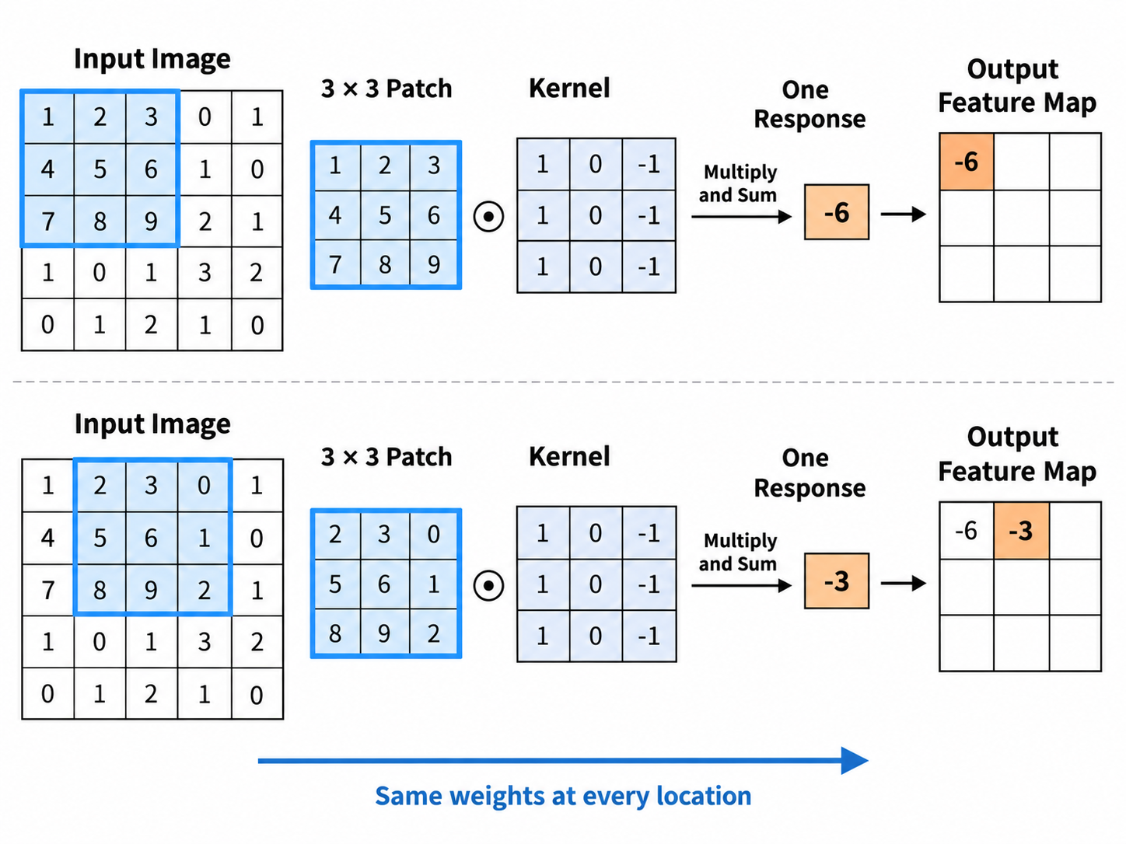
Convolution Computation over Sliding Window
Multiply nine input values by nine kernel weights, add the products, then add the bias.
At each time, the result fills one position in the output feature map

Slide 27
Padding and Stride
Padding adds a border around the input, making sure every pixel can be in the center of a sliding window
Original 5 × 5 input
7 × 7 padded input
Gray cells are the added border
P = 1
→
Stride controls how far the kernel moves
Start
Move 1 cell
Move 2 cells
1
2
0
1
3
1
2
0
1
3
1
2
0
1
3
0
1
2
2
1
S = 1
→
0
1
2
2
1
S = 2
→
0
1
2
2
1
2
3
1
0
2
2
3
1
0
2
2
3
1
0
2
1
0
2
3
1
1
0
2
3
1
1
0
2
3
1
3
1
1
2
0
3
1
1
2
0
3
1
1
2
0
Stride 1 checks more overlapping locations.
Stride 2 checks fewer locations and gives a smaller output.

Slide 28
Stride and Padding Control Output Size
H_out = floor((H + 2P − K) / S) + 1
Example: H = 5, K = 3
Padding adds border values before convolution.
Stride controls how far the kernel moves.
Both change the spatial size of the feature map.
P = 0, S = 1 gives H_out = 3
P = 1, S = 1 gives H_out = 5
P = 1, S = 2 gives H_out = 3
“Same” padding with a 3 × 3 kernel uses P = 1 when S = 1.

Slide 29
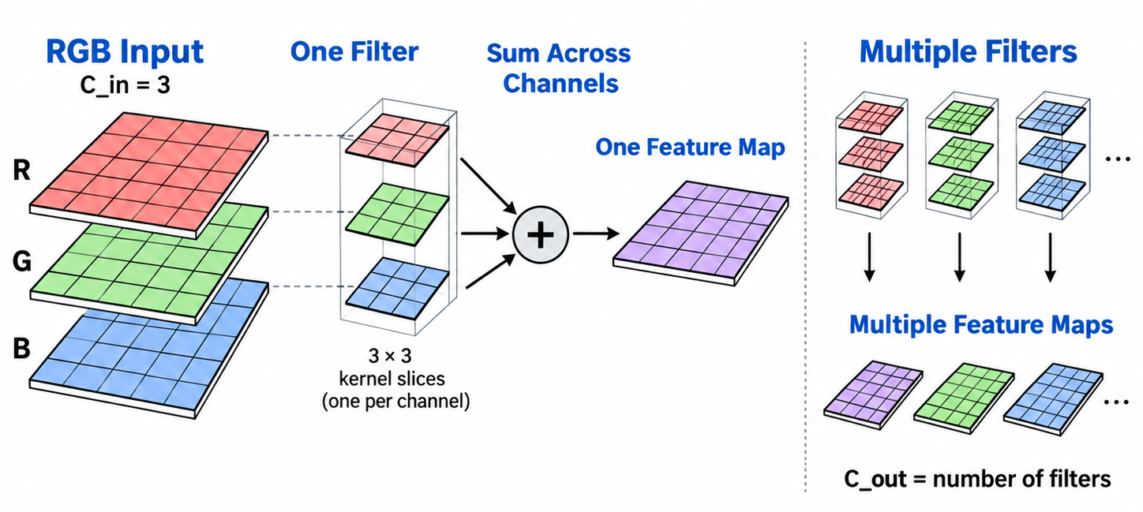
Channels and Multiple Filters
Input: [B, C_in, H, W]
Kernel bank: [C_out, C_in, K, K]
One filter spans all C_in input channels. It computes one spatial feature map.
C_out different filters produce C_out output feature maps.
The output tensor has shape [B, C_out, H_out, W_out].

Slide 30
CNN Tensor Shape and Channel Changes
Input tensor
[B, C_in, H, W]
C_in channels
Kernel bank
[C_out, C_in, K, K]
C_out filters
Output map
[B, C_out, H′, W′]
C_out feature maps
27

Slide 31
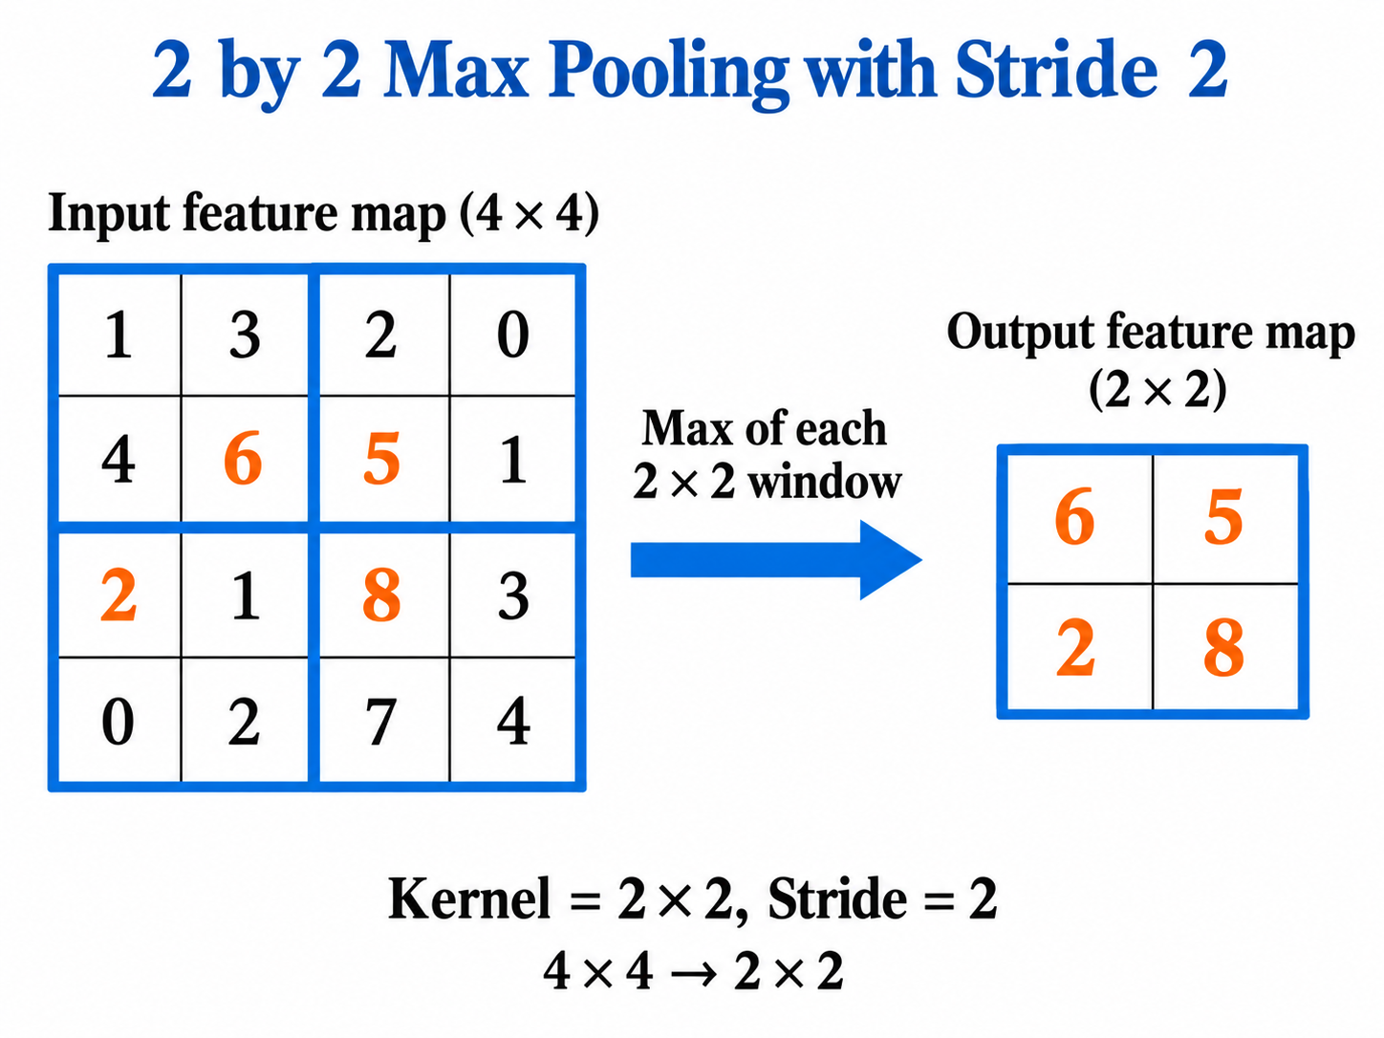
Max Pooling
A 2 × 2 window keeps only its largest activation, then moves by the stride.
Pooling has no learned weights; it reduces spatial resolution

Slide 32
Max vs Average Pooling
Input feature map
Max Pooling
Average Pooling
1
5
2
4
5
6
2.75
3
3
2
6
0
8
1
3
7
8
7
3.75
4
2
4
5
1
Keeps the strongest response
Keeps the average response
2 × 2 window
Pooling processes each window independently and reduces width and height.

Slide 33
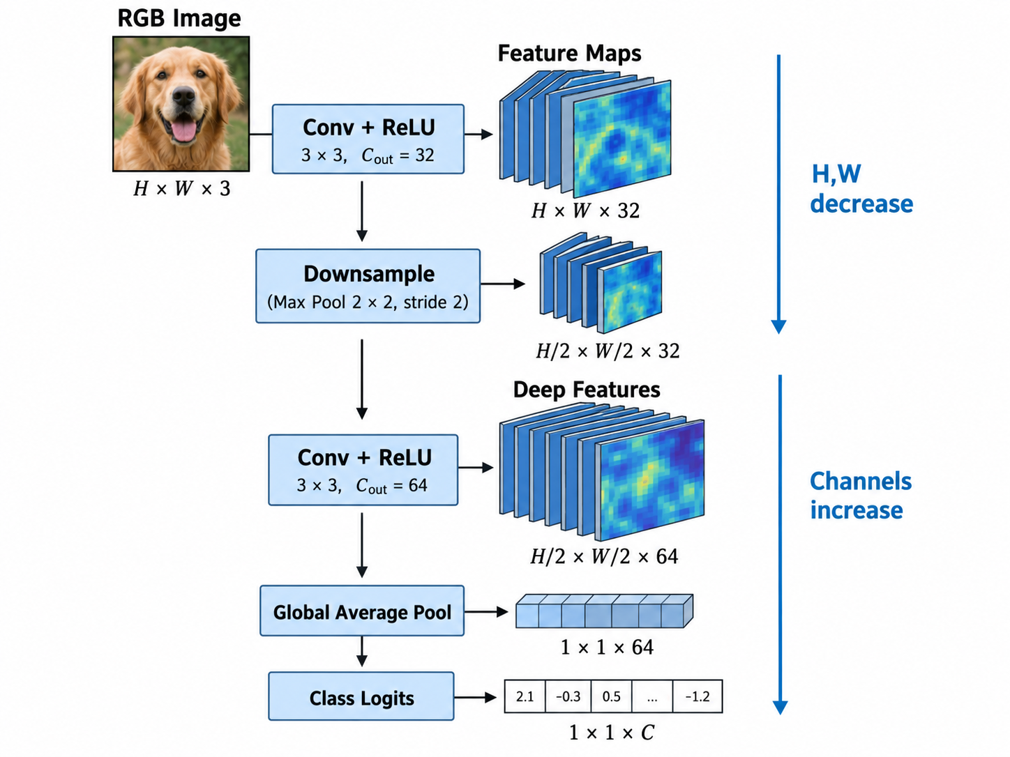
A Complete CNN Inference Pipeline
Spatial resolution decreases while feature channels increase.
A classifier (MLP) head maps the pooled feature vector to logits.
Spatial dimensions usually decrease while the number of channels increases.
Image → feature maps → deep features → class logits

Slide 34
Roadmap
Part I Neural-network foundations ✓
Part II Multilayer Perceptrons ✓
Part III Convolutional Neural Networks ✓
Part IV Transformers and architecture comparison

Slide 35
Part IV — Transformers
How can every patch directly gather information from others
gobally and more easily?

Slide 36
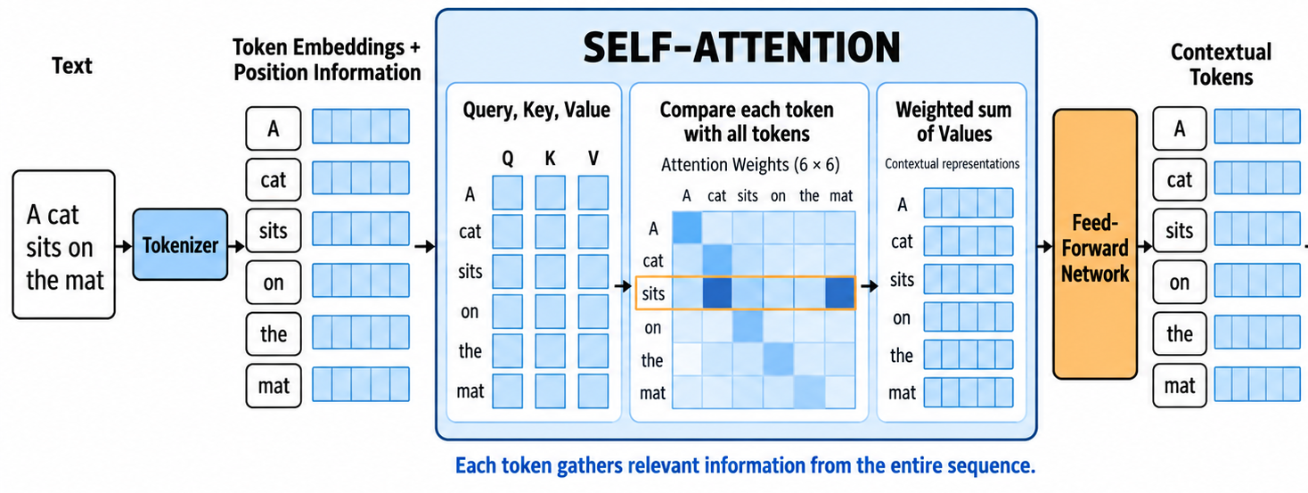
Pipeline Overview

Slide 37
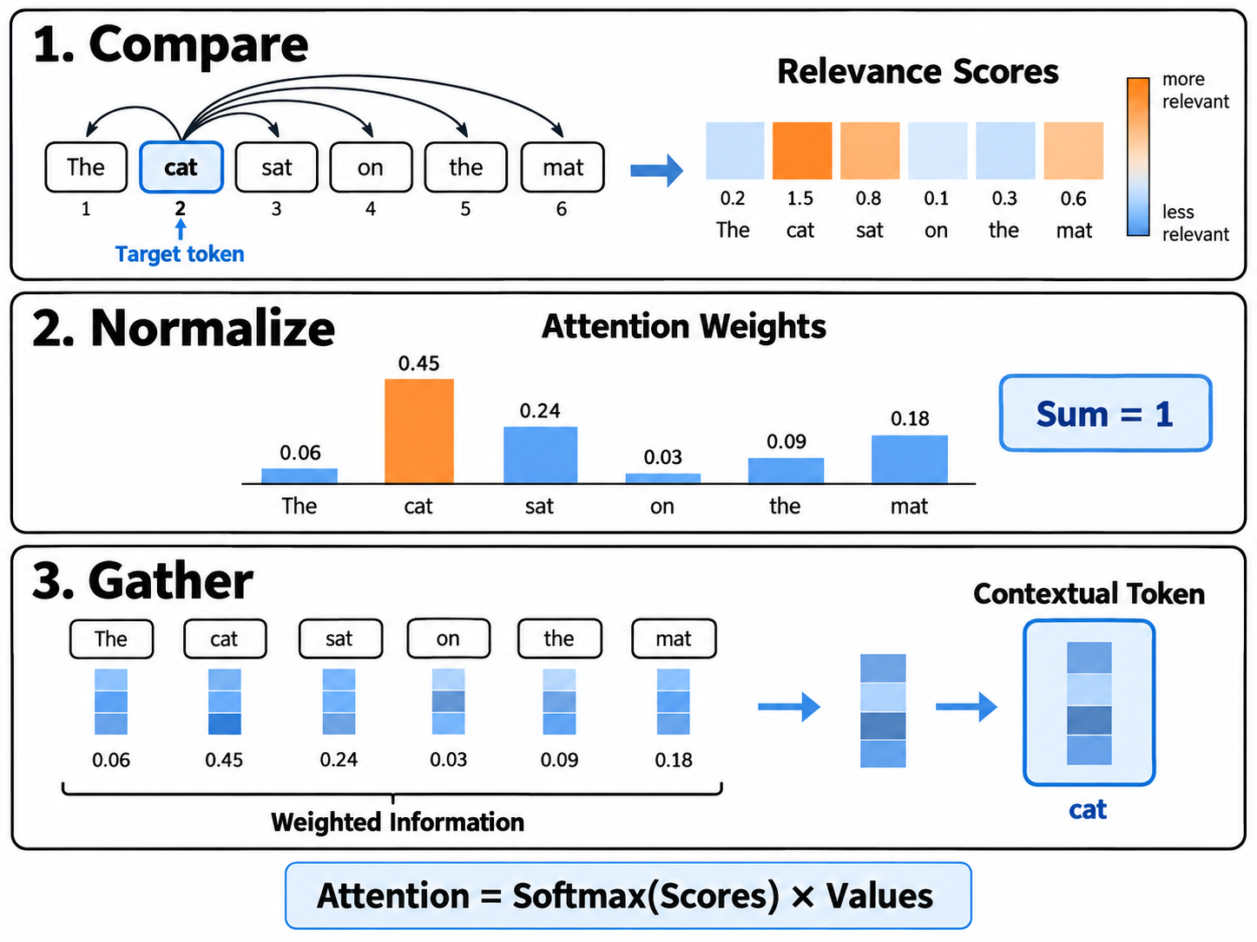
Three Steps of Attention

Slide 38
Token Evolving Process
Current token
Learn what matters from data individually
Communiate with other tokens
Normalize the relevance scores with all tokens
Update its own embeddings with weighted sum
Larger weights means more related

Slide 39
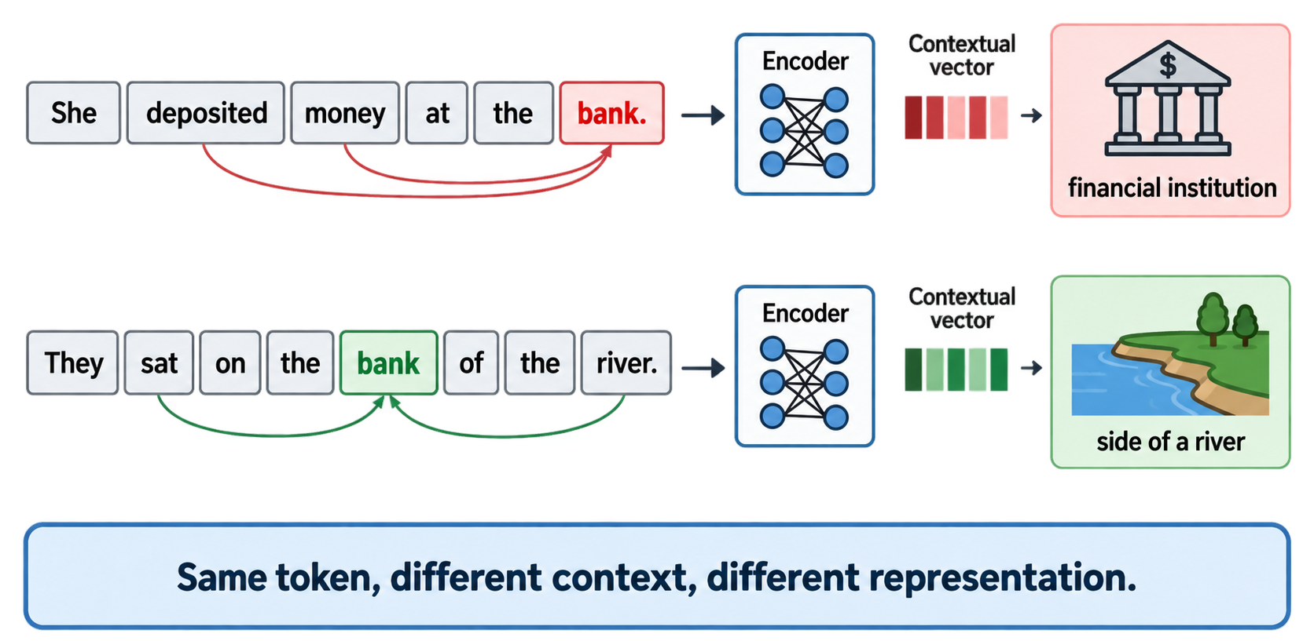
Context Changes Token Meaning
Exactly the same initial token embeddings
48

Slide 40
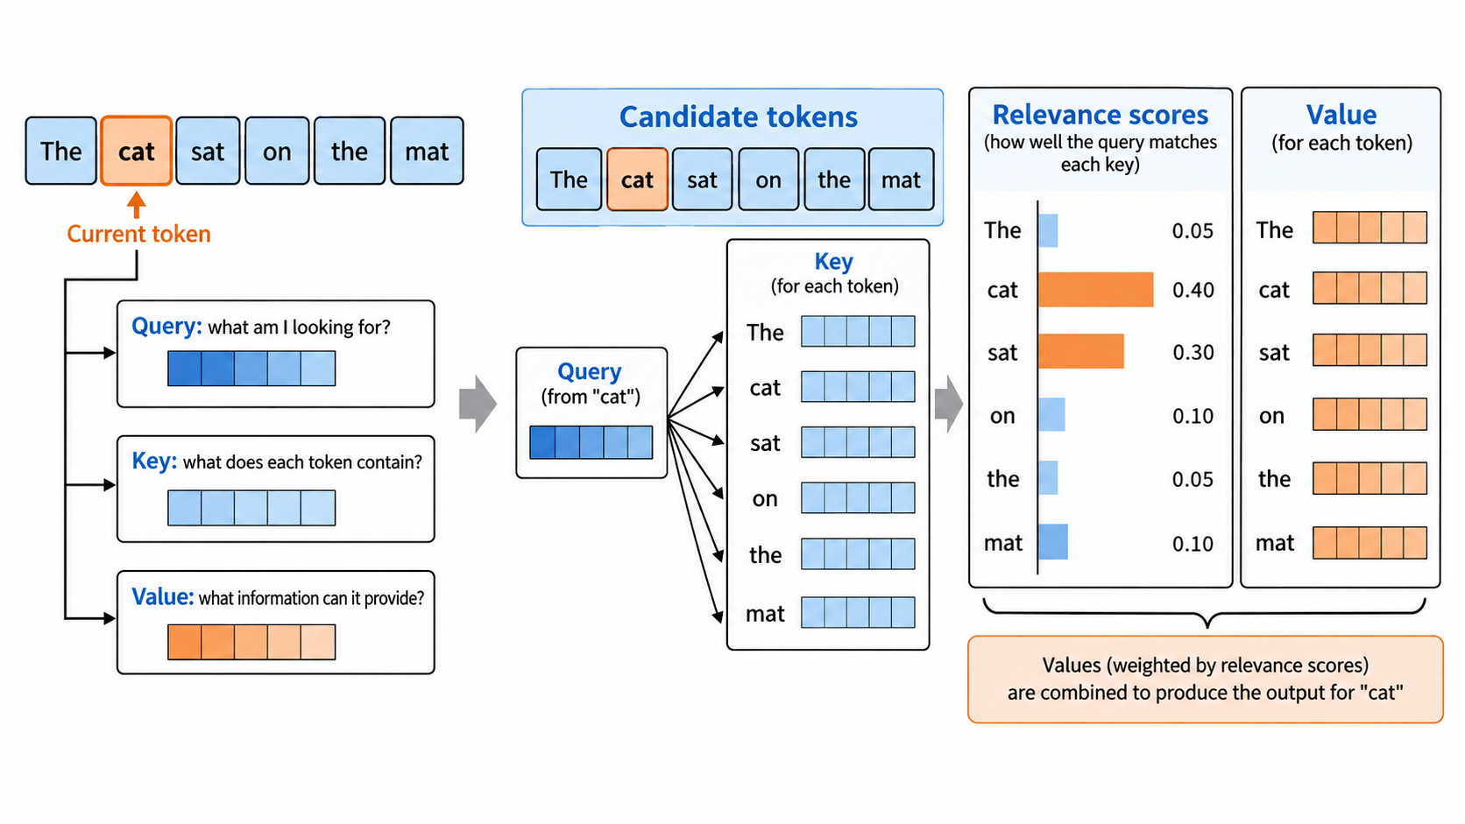
How to Perform Self-Attention
The same token participates in attention through three different roles.
Why does each token compute similarity with its own?
Query searches, Keys support matching, and Values carry the information that will be collected.

Slide 41
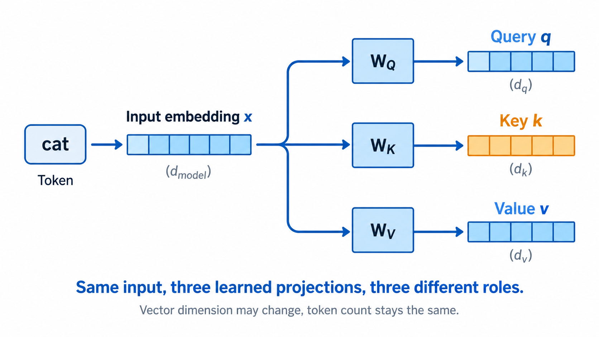
Step 0: Creating Query, Key, and Value Vectors
Each input embedding passes through three learned linear projections.
Every token creates its own q, k, and v vectors before the attention comparison begins.

Slide 42
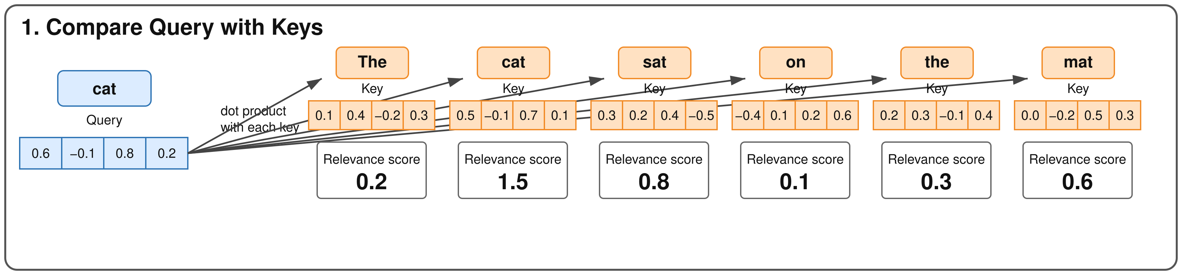
Step 1: Query–Key Similarity
The current token uses its Query to match every candidate Key.
One candidate, one score
Six candidate tokens produce six relevance scores.
Changing scores
The scores change when the sentence or the current token changes.
Larger means closer
A larger score indicates a stronger Query–Key match before normalization.

Slide 43
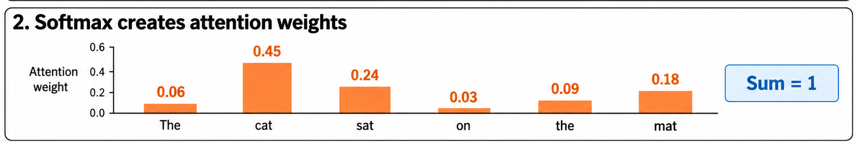
Step 2: Softmax Attention Weights
Softmax turns arbitrary relevance scores into usable weights.
αᵢ = Softmax(sᵢ) = exp(sᵢ) / Σexp(sⱼ), j=1...n
s = [0.2, 1.5, 0.8, 0.1, 0.3, 0.6] α ≈ [0.10, 0.37, 0.18, 0.09, 0.11, 0.15]
Positive weights
Every candidate receives a weight greater than zero.
Sum equals 1
The weights form a distribution over candidate tokens.
Relative importance
A high score receives more weight, but every score is considered together.

Slide 44
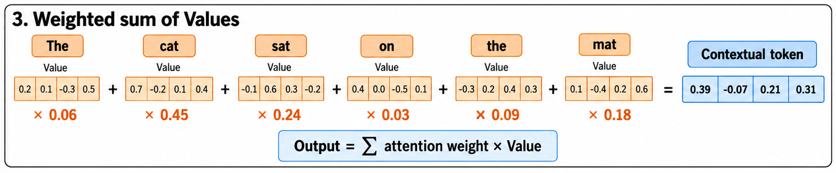
Step 3: Weighted Sum of Values
Attention weights decide how much information to take from each Value.
Scale
Each Value vector is multiplied by its attention weight.
Add
The weighted Value vectors are added element by element.
The same output shape
The result has one vector per target token and the Value feature dimension.

Slide 45
Every Token Has Its Own Attention Distribution
The model repeats Compare, Normalize, and Gather for every Query token.
Query / Key | The | cat | sat | on | the | mat
The | 0.38 | 0.12 | 0.16 | 0.08 | 0.10 | 0.16
cat | 0.06 | 0.45 | 0.24 | 0.03 | 0.09 | 0.13
sat | 0.05 | 0.28 | 0.34 | 0.08 | 0.09 | 0.16
on | 0.09 | 0.07 | 0.12 | 0.27 | 0.18 | 0.27
the | 0.13 | 0.12 | 0.10 | 0.16 | 0.31 | 0.18
mat | 0.07 | 0.14 | 0.17 | 0.14 | 0.13 | 0.35
Each row sums to 1 and produces one contextual output token.
Rows are Queries. Columns are Keys.

Slide 46
What Changes After Attention?
Attention preserves the sequence length but changes the meaning carried by each token vector.
Input tokens
Self-Attention
Contextual tokens
Every token gathers
weighted information
from the sequence
→
→
Same number of tokens
Same output dimension per token
Different contextual representation
Attention updates what each token represents. It does not automatically reduce the sequence length.

Slide 47
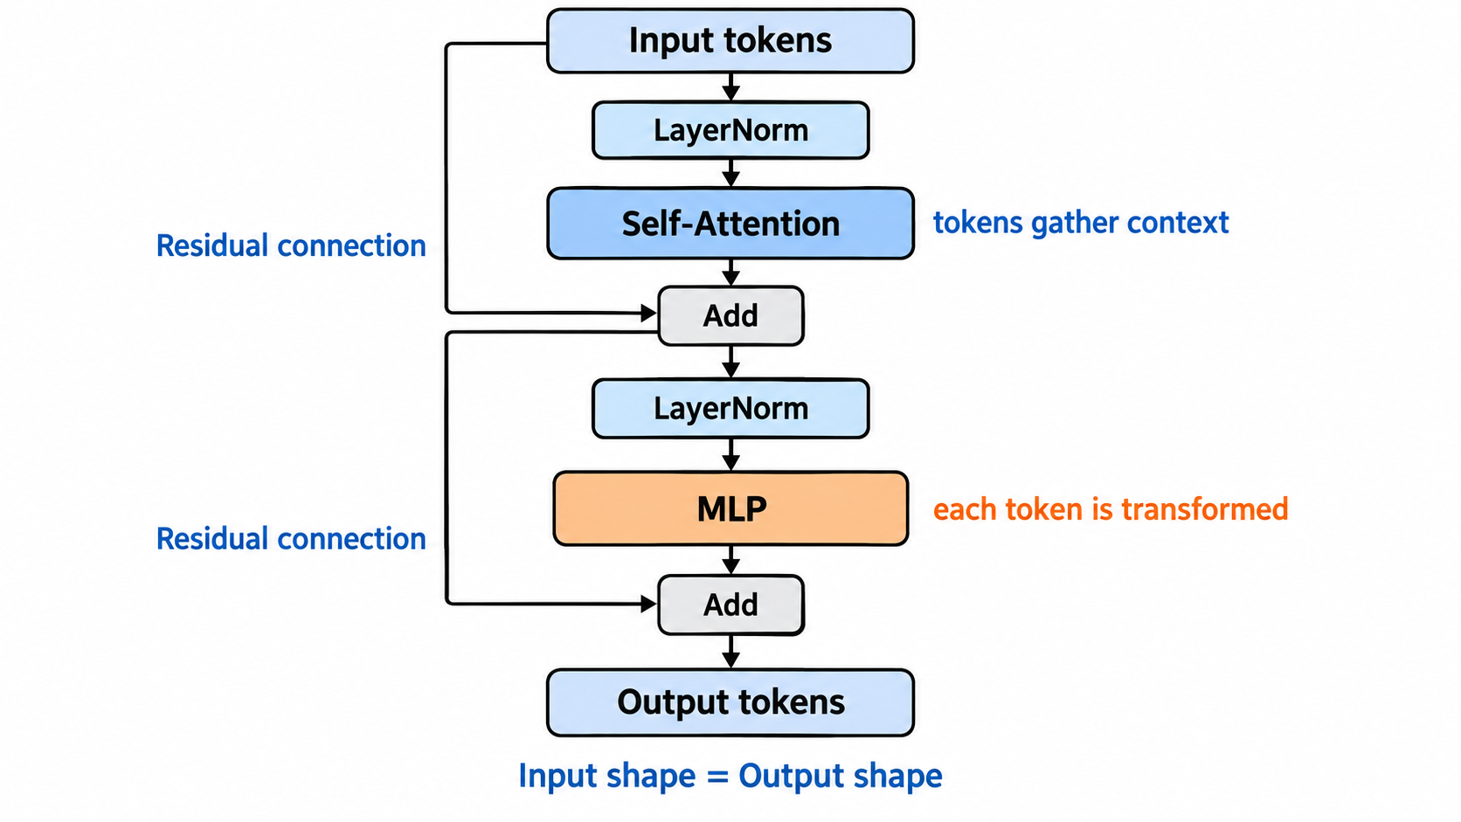
Transformer Layer Overview
A Transformer layer contains two main sublayers and two residual updates.
Attention mixes information across tokens. The MLP transforms features inside each token.

Slide 48
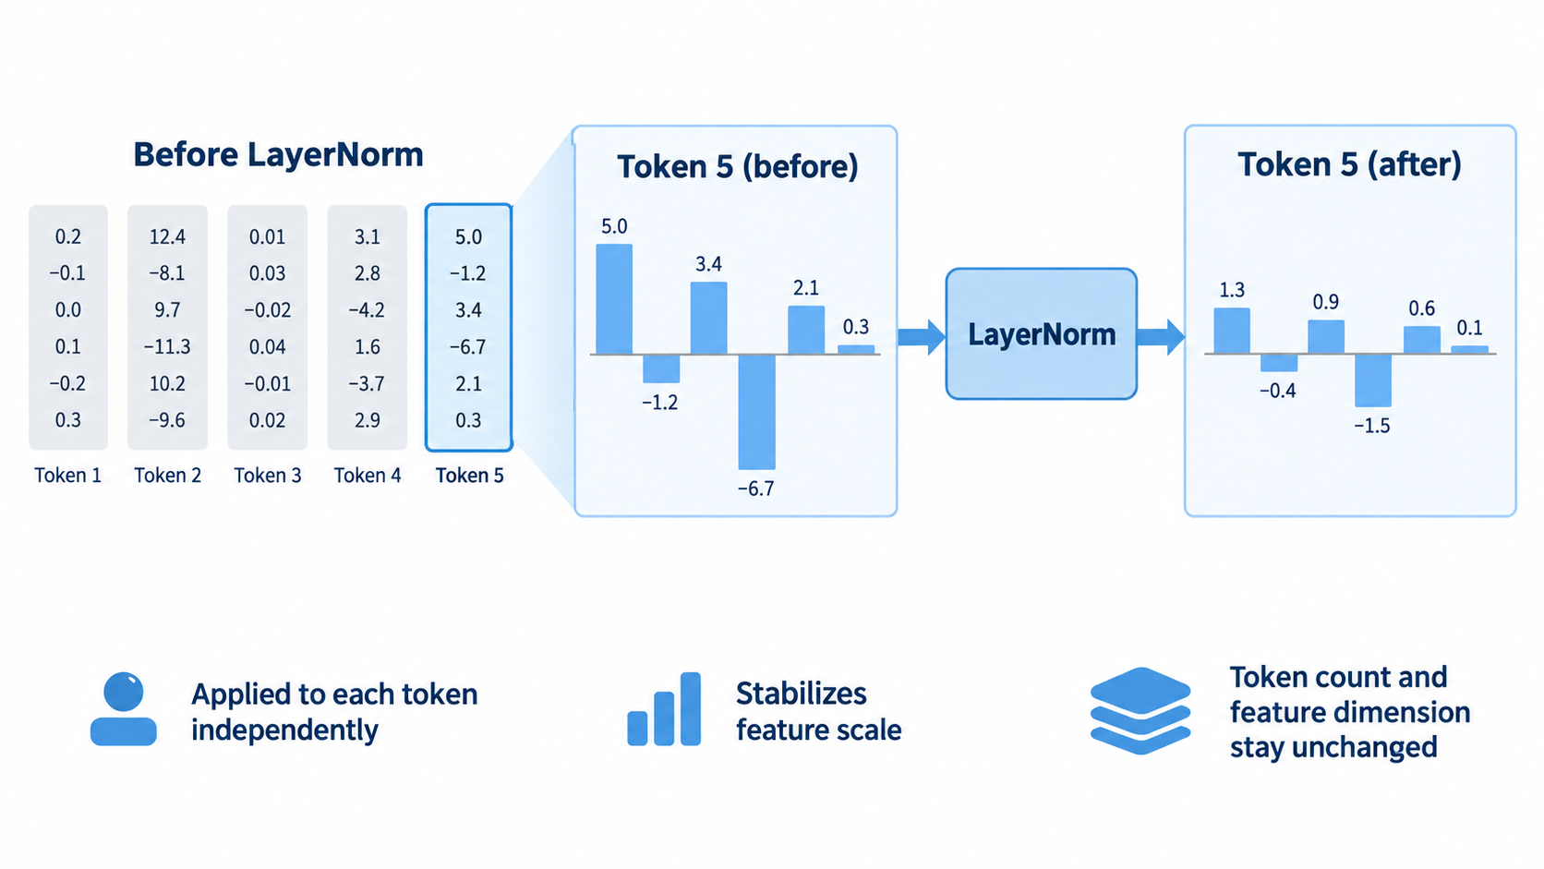
Layer Normalization
LayerNorm stabilizes the feature scale of each token before a sublayer.
LayerNorm changes feature values, not the number of tokens or the feature dimension.

Slide 49
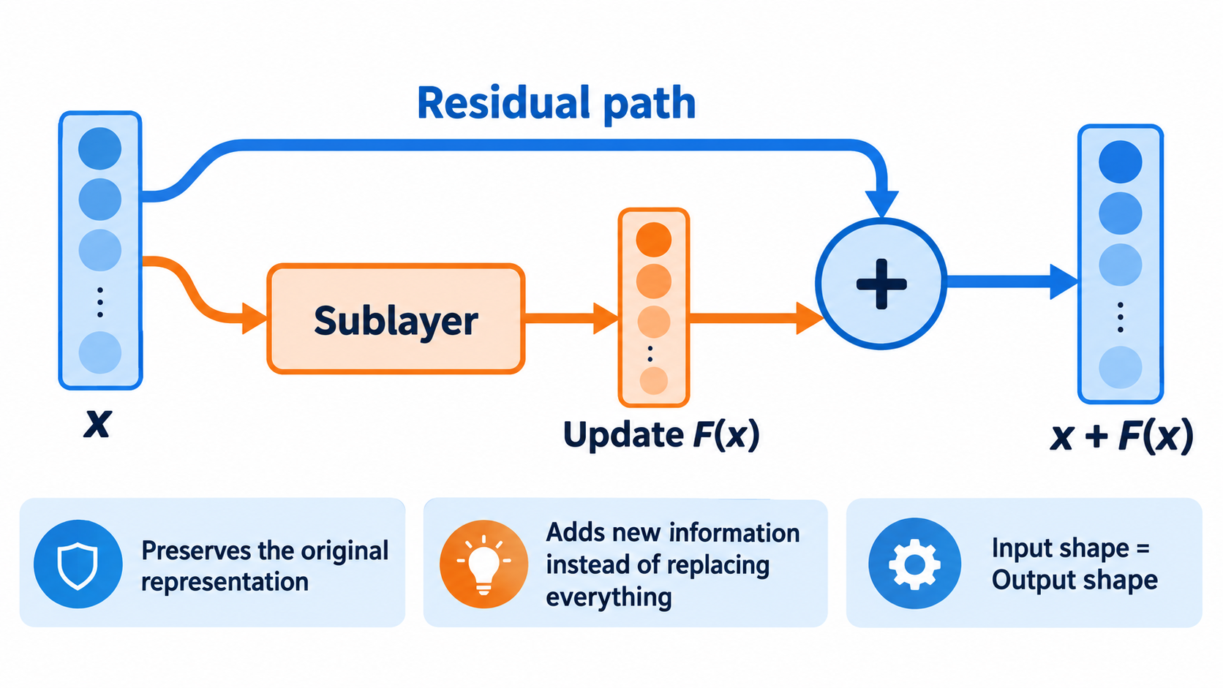
Residual Connections
A residual path carries the input forward while the sublayer contributes an update.
The output retains earlier information and adds the new result from attention or the MLP.

Slide 50
Complete Transformer Layer Data Flow
Follow one token sequence through a complete layer.
1
Input tokens
N tokens, each with D features
2
LayerNorm
Normalize features inside each token
3
Self-Attention
Every token gathers context from the sequence
4
Residual Add
Add the attention update to the layer input
5
LayerNorm + MLP
Transform each token independently
6
Residual Add
Produce N output tokens with D features
Input shape [B, N, D] = Output shape [B, N, D]

Slide 51
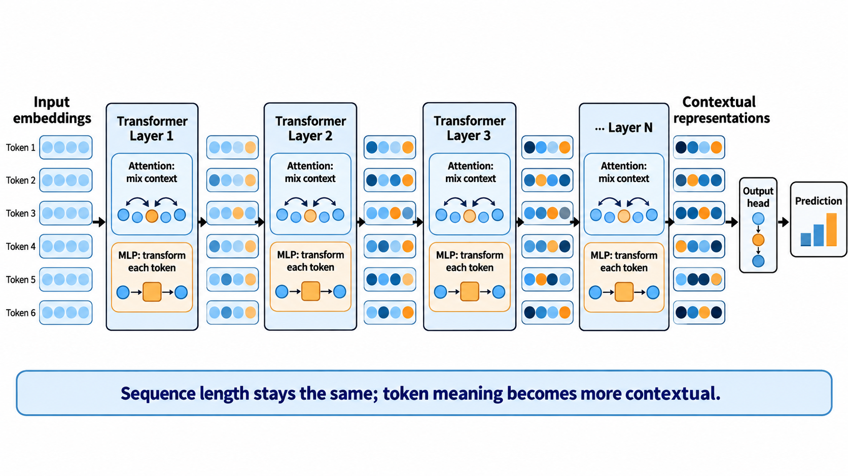
Stacking Transformer Layers
Each layer repeats context mixing and token-wise feature transformation.
Later layers can represent more abstract relationships while keeping one vector for each token.

Slide 52
MLP, CNN, and Transformer: Core Differences
Property | MLP | CNN | Transformer
Natural input | Feature vector | Spatial grid | Token sequence
Connection | Dense | Local, shared kernel | Global, content dependent
Built-in assumption | No locality | Nearby pixels matter | Relevant tokens may be distant
Output | Feature vector | Feature maps | Contextual token sequence
Choose an architecture whose connection pattern matches the structure of the input.

Slide 53
MLP Implementation in PyTorch
An MLP flattens the image and applies fully connected layers.
Minimal implementation
Data flow
class SimpleMLP(nn.Module):
def __init__(self):
super().__init__()
self.flatten = nn.Flatten()
self.fc1 = nn.Linear(784, 128)
self.fc2 = nn.Linear(128, 10)
def forward(self, x):
x = self.flatten(x)
x = F.relu(self.fc1(x))
return self.fc2(x)
Image batch
[B, 1, 28, 28]
Flatten
[B, 784]
Linear + ReLU
[B, 128]
Class scores
[B, 10]
Key details
784 = 28 × 28 pixels
128 = hidden features
10 = output classes

Slide 54
CNN Implementation in PyTorch
A CNN preserves the image grid and extracts local patterns with shared kernels.
Minimal implementation
Tensor shapes
class SimpleCNN(nn.Module):
def __init__(self):
super().__init__()
self.conv = nn.Conv2d(
1, 16, kernel_size=3, padding=1)
self.pool = nn.MaxPool2d(2)
self.fc = nn.Linear(16*14*14, 10)
def forward(self, x):
x = F.relu(self.conv(x))
x = self.pool(x)
x = torch.flatten(x, 1)
return self.fc(x)
Input image
[B, 1, 28, 28]
3 × 3 convolution + ReLU
[B, 16, 28, 28]
2 × 2 max pooling
[B, 16, 14, 14]
Flatten + Linear
[B, 10]
Why these numbers?
16 filters create 16 feature maps.
Padding keeps 28 × 28. Pooling halves it to 14 × 14.

Slide 55
Transformer Self-Attention in PyTorch
This single-head implementation exposes the attention calculation step by step.
Minimal self-attention
Attention calculation
import math
class SelfAttention(nn.Module):
def __init__(self, d):
super().__init__()
self.q = nn.Linear(d, d)
self.k = nn.Linear(d, d)
self.v = nn.Linear(d, d)
def forward(self, x):
Q, K, V = self.q(x), self.k(x), self.v(x)
scores = Q @ K.transpose(-2, -1)
scores = scores / math.sqrt(x.size(-1))
weights = torch.softmax(scores, dim=-1)
output = weights @ V
return output, weights
Input tokens X
[B, L, D]
Q, K, V projections
[B, L, D]
QKᵀ / √D
Scores [B, L, L]
Softmax
Weights [B, L, L]
Weights × V
Output [B, L, D]
L: sequence length D: embedding dimension
Each row of weights sums to 1.

Slide 56
Strengths and Limitations
Architecture | Main strength | Main limitation
MLP | Simple and effective for compact feature vectors | Loses spatial or sequential structure when inputs are flattened
CNN | Efficient local processing with strong image bias | Direct global interaction usually requires more layers
Transformer | Flexible global context and variable token sequences | Attention cost increases quickly with sequence length
Modern systems often combine these structures instead of relying on only one.

Slide 57
Typical Application Scenarios
Match the model to both the input structure and the required interactions.
MLP
Compact vectors and tabular features
Classification heads, projections, simple baselines
CNN
Images and spatial sensor grids
Recognition, detection, segmentation, local visual features
Transformer
Text or long token sequences
Language modeling, vision tokens, audio, multimodal reasoning
Combined
Local perception plus global reasoning
Vision encoder or CNN + Transformer + MLP heads

